Slide 1


Slide 2
Neural Networks
Notes:
In London

Slide 3
Topics for today
Vectors revisit
Perceptron learning
Moving from Perceptron to Neural Networks (Derivation)
Notes:
In London

Slide 4
Why Neural Networks ?
As the number of quadratic, cubic or high order independent variables increase the regression model becomes more computationally expensive. For Ex if we have say 100 features and we want to include the combination of features such as (x1^2,x1.x2,x1.x3..x1.x100,x2^2,...........,x100^x100) then 100 features are now appx. 5000 . Regression is not good with so much quadratic or higher order features.
Notes:
In London

Slide 5
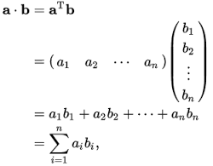
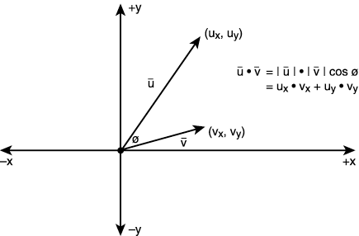
Little bit of Algebra here …..
Dot Product of 2 vectors
Notes:
In London

Slide 6
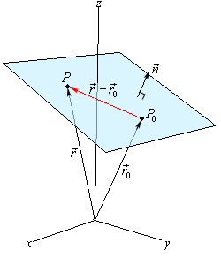

Equation of a plane using a Normal vector and position vector passing through the plane
Notes:
In London

Slide 7
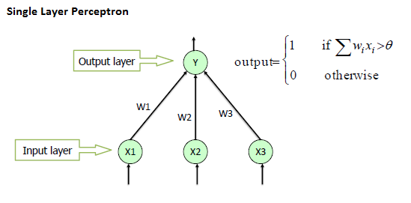
Single layer Neural network (PERCEPTRON)
A perceptron takes several binary inputs, x1,x2,…x1,x2,…, and produces a single binary output:
{
1 If Σw_{i}x_{i} – θ > 0
Output =
0 otherwise
y
w1
θ
w2
w3
x1
x2
x3
-1
Add an extra component with value 1 to each input vector. The “bias” weight on this component is minus the threshold. Now we can forget the threshold.
Notes:
In London

Slide 8
Question
Suppose we take all the weights and biases in a network of perceptrons, and multiply them by a positive constant, c>0. Show that the behaviour of the network doesn't change.
Notes:
In London

Slide 9
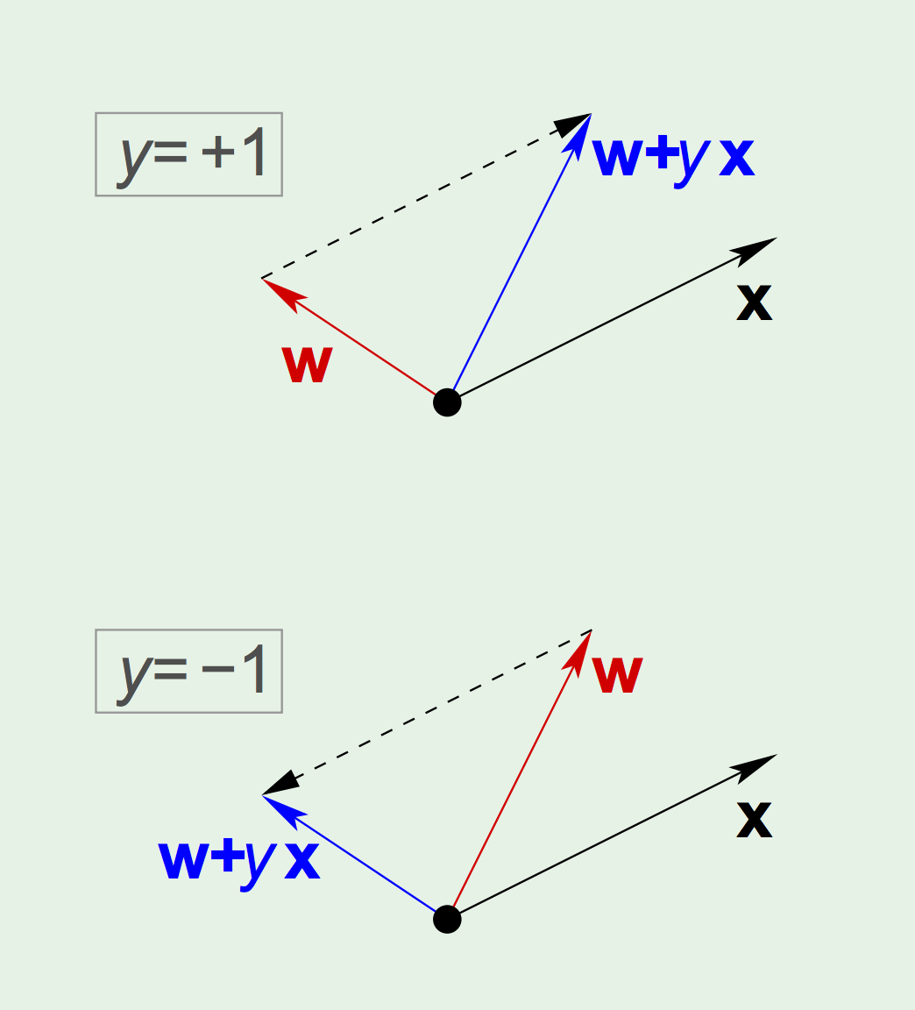
Graphical Understanding
Notes:
In London

Slide 10
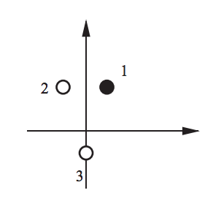
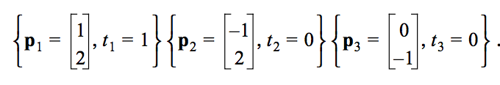
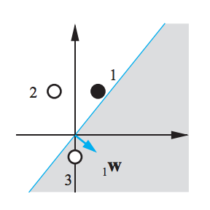
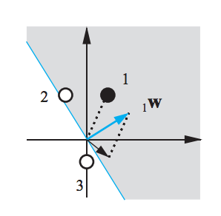
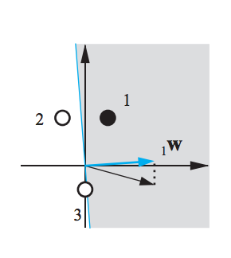
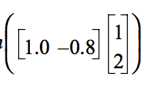
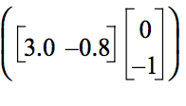

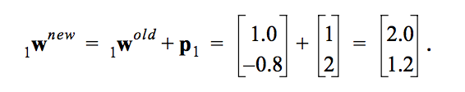
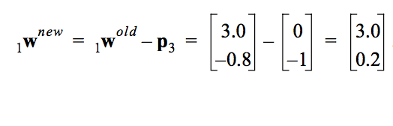
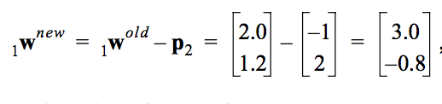
Test Problem
Input 1
Input 2
Input 3
-0.6
0.2
3.8
Notes:
In London

Slide 11
The perceptron convergence procedure: Training binary output neurons as classifiers
If the output unit is correct, leave its weights alone.
If the output unit incorrectly outputs a zero, add the input vector to the weight vector.
If the output unit incorrectly outputs a 1, subtract the input vector from the weight vector
Notes:
In London

Slide 12
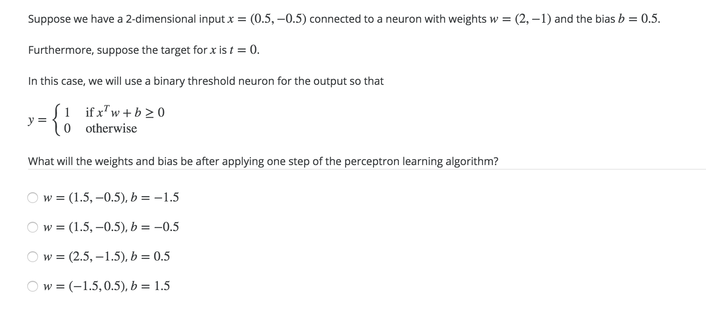
Question

Slide 13
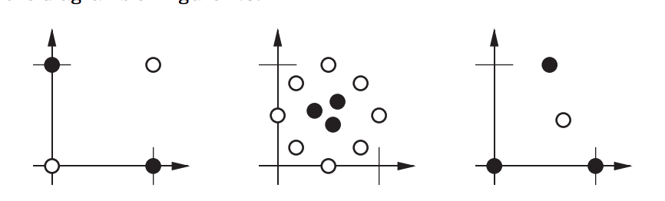
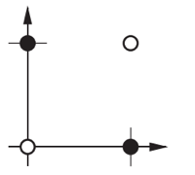
Limitations of Perceptron learning
Linear In-seperable problem
What Neural Network can do ?
Notes:
In London

Slide 14

NN for handwritten digits
Notes:
we don't usually appreciate how tough a problem our visual systems solve
This becomes difficult if we start writing a computer program for this
What seems easy when we do it ourselves suddenly becomes extremely difficult
a 9 has a loop at the top, and a vertical stroke in the bottom right. turn out to be not so simple to express algorithmically. When you try to make such rules precise, you quickly get lost in a morass of exceptions and caveats and special cases. It seems hopeless

Slide 15
The Human Brain and Neural Networks
Smart scientists have been figuring even today that how human brain works.
Tiny part of brain that lets do things and smart things are called neurons.
Communicate via impulsive signals called synapses which helps us think.
Same idea is of neural networks.

Slide 16
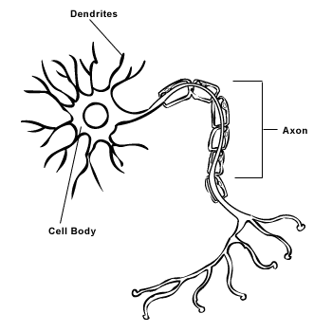
Transfer Function (the processing part)
Input Layer
Weight(Synapses)
Output Layer
Synapses
Notes:
Human Artificial
Neuron Processing Element
Dendrites Combining Function (Activation function)
Cell Body Transfer Function (Summation)
Axons Element Output
Synapses Weights

Slide 17
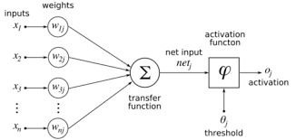
Math behind Neural Networks
{
0 , if φ*netj < t
1 , if φ*netj >= t
net_{j} = x1*w1 + x2* w2+….. Xn*wn
Oj =
Notes:
In London

Slide 18
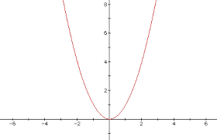
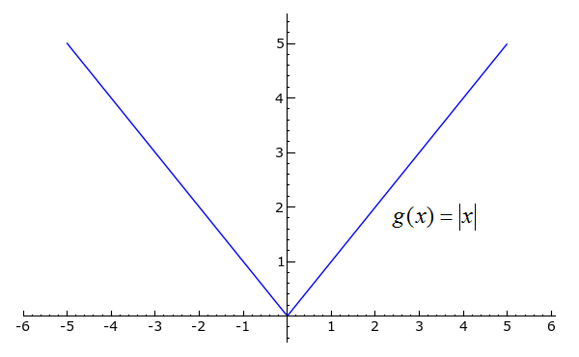
Neural Networks
Actual Output = f(x,w,t)
Desired Output = d(x)
Actual Performance Function = |d(x) – f(x,w,t)|²
Performance Function = |d(x) – f(x,w,t)|
f(x) = |x|² , then d(f(x))/d(x) = 2x and we solve for 2x = 0 ie x=0
f(x) = |x|, then d(f(x))/d(x) = x/|x| and we cannot solve for x/|x| = 0
Note : We add – sign so the function becomes -|d(x) – f(x,w,t)|² as in upper parabola it seems like as the cost increases the improvement increases but that is not the case so we invert the parabola
Notes:
In London

Slide 19


Why Sigmoid function
1
0
Step Function which is Non Differentiable and we cannot solve this through gradient Descent because gradient descent requires function to be differentiable
1/(1 + $e^{−x}$)
Notes:
In London

Slide 20
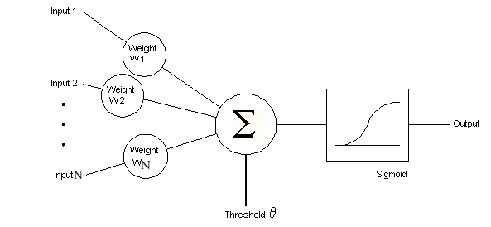
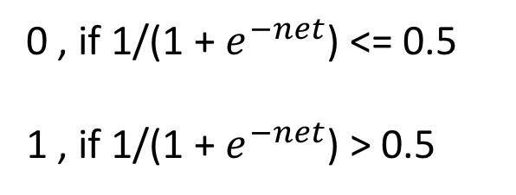
net_{j} = x1*w1 + x2* w2+….. Xn*wn – (threshold)
{
0 , if 1/(1 + $e^{−net}$) <= 0.5
1 , if 1/(1 + $e^{−net}$) > 0.5
This is just an example , the number 0.5 can be varied accordingly.
Oj =
Notes:
In London

Slide 21
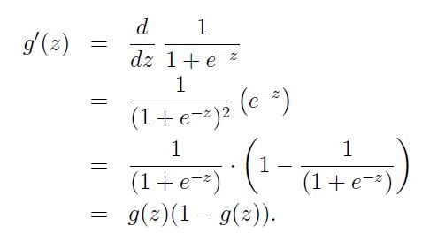






World’s Simplest Neuron
W1
W2
X
P1
Y
P2
Z
P(Performance)=-1/2(d-z)²
$$\frac{∂Z}{∂W2}$$
$$\frac{∂P}{∂W2}=\frac{∂P }{∂Z}$$
Chain Rule
$$\frac{∂Z}{∂P2}$$
$$\frac{∂P}{∂W2}$$
$$\frac{∂P2}{∂W2}$$
= (d – Z) Z (1-Z) Y
$$\frac{∂P}{∂W2}=\frac{∂P }{∂Z}$$
= Y as P2 = Y.W2
= Z(1 – Z)
= (d – z) as P(Performance)=-1/2(d-z)²
Notes:
In London

Slide 22





Derivation cont.
a_{i}
a_{j}
a_{k}
𝓢_{k}
∆w_{kj} = (t_{k}− a_{k}) a_{k} (1 − a_{k} ) a_{j}
Layer i
Layer j
Layer k
∆w_{kj} = 𝓢_{k} a_{j}
For Hidden Weights
∆w_{kj} =[Σ
]
$$\frac{∂netj}{∂wji}$$
$$\frac{∂netk}{∂aj}$$
$$\frac{∂aj}{∂netj}$$
$$\frac{∂ak}{∂netk}$$
$$\frac{∂E}{∂ak}$$
𝓢_{j}
𝓢_{k}
∆w_{kj} =[Σ(t_{k}− a_{k}) a_{k} (1 − a_{k} )w_{kj}]a_{j}(1-a_{j})a_{i} = [Σ𝓢_{k}W_{kj}] a_{j}(1-a_{j})a_{i}
∆w_{ji} = 𝓢_{j}a_{i}
Notes:
In London

Slide 23
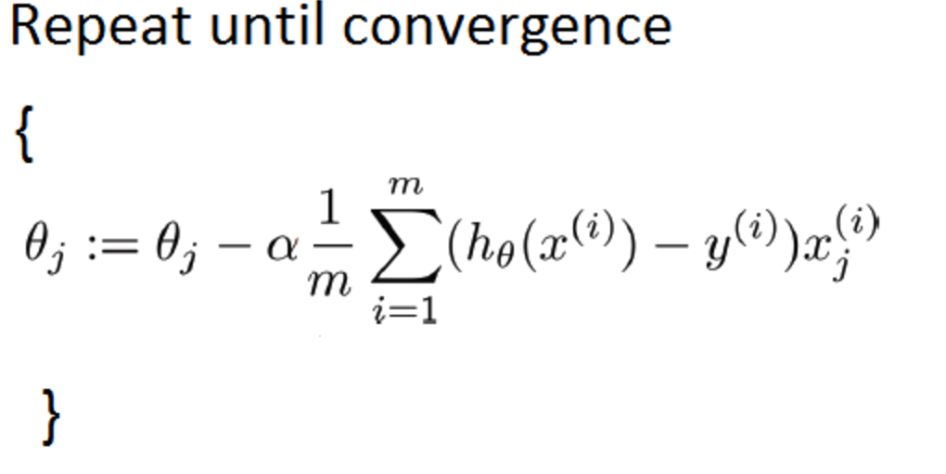
Types of Gradient Descent
Batch Gradient Descent
we use the complete dataset available to compute the gradient of cost function.
batch gradient descent can be very slow and is intractable for datasets that don't fit in memory
Notes:
In London

Slide 24
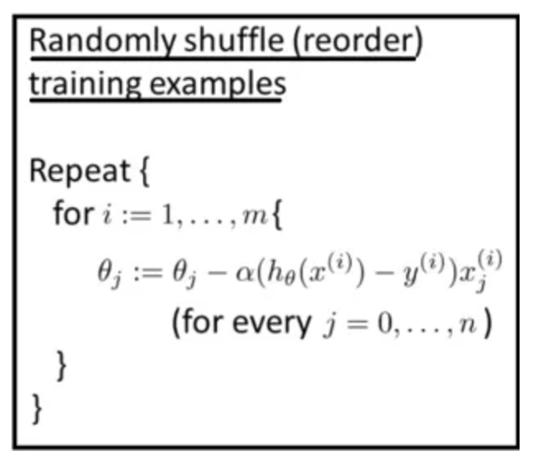
2. Stochastic Gradient Descent
we use the 1 training Example to compute the gradient of cost function.
Stochastic gradient descent is very fast but accuracy is low
Notes:
In London

Slide 25
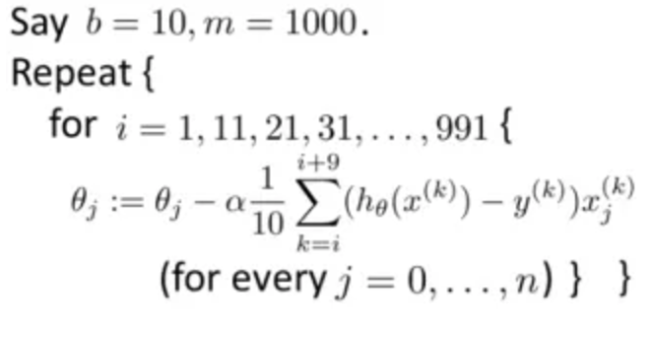
3. Mini Batch Gradient Descent
we use the a batch of m training Example to compute the gradient of cost function.
Mini Batch gradient descent is faster then batch and accuracy is higher than Stochastic
Notes:
In London

Slide 26
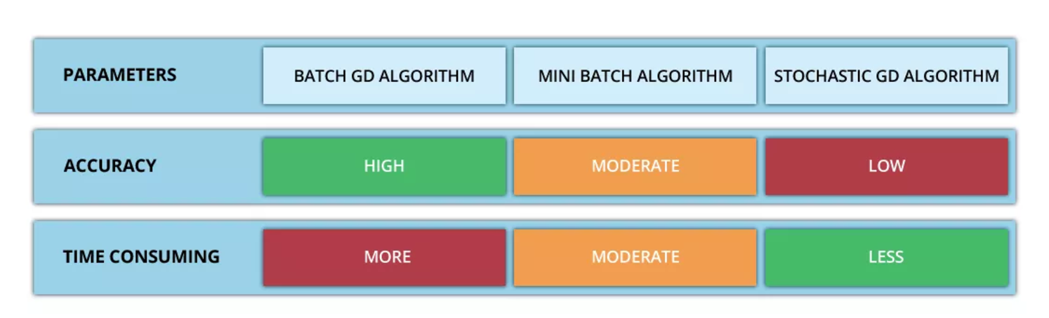
Notes:
In London

Slide 27
Problem Solving XOR Using Neural Networks
Notes:
In London

Slide 28
Q/A
Notes:
In London

